Slide 1
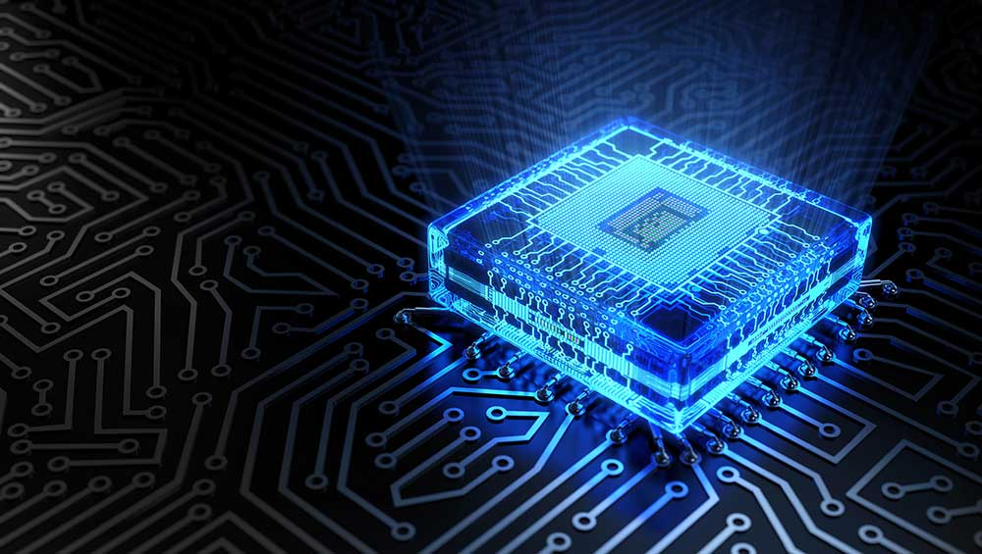
Identifying Wafer Failures with Deep Learning
A CA2 Project by
Ong Boon Ping
Tan Chin Gee
Han Dongchou Francis

Slide 2
Description
In wafer probe testing, VDD resistance is measured. The VDD resistance is an indication of the quality of the memory chip.
The test results not only sorts out problematic or failing components, but they also help us understand whether the wafer fabrication processes have any issues.
To find out whether the fabrication processes have any problems, we measure the resistance distribution across the wafer. This can help to identify the source of the problem (whether it’s the wafer preparation, or grinding, or cutting).

Slide 3
Complication
Wafer cutting and grinding issues usually involve components around the wafer edge while material related problems can be taking place in any region.
Wafer cutting issues usually happen around a certain edge of the wafer but wafer grinding poses problem around a larger area at the wafer edge.
Hence, the three types of wafer failures may not be easily distinguished.

Slide 4
Application of Deep Learning
In this project, we apply deep learning neural network on wafer maps with pre-determined failing type.
After the wafer failing pattern is represented by the neural network, the prediction can be made.
The accuracy can be increased with more wafer failing patterns.

Slide 5
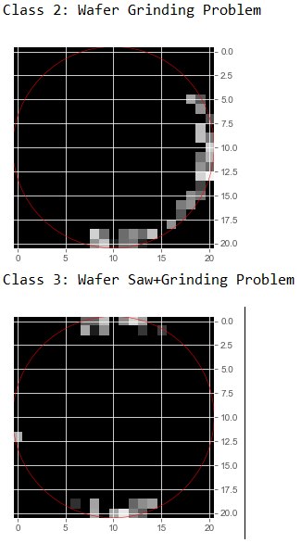
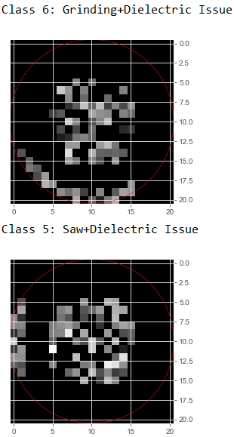
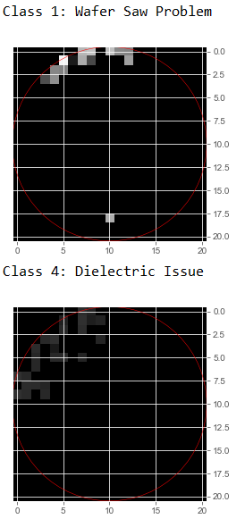
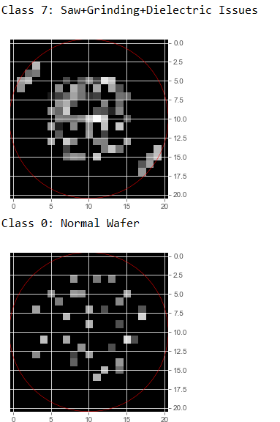
Types of Wafer Problems

